Slide 1



Nyx- Educational Assistant for the Visually Impaired
Department of Computer Science and Engineering
Sustainable Development Goals-4 (Quality education)
Team Members Name / Register Number GOWTHAM. J(211420104085) HARI HARAN. S(211420104089) GOPINATH. N V(211420104083)
Guide Name & Designation
Dr. N.PUGHAZENDI M.E, PhD
Coordinator Name & Designation
Dr. N.PUGHAZENDI M.E, PhD
1

Slide 2
Introduction
All individuals require quality education to develop and advance in this knowledge driven world.
The current educational curriculum is oriented towards the utilization of eyesight. Individuals who are blind or visually impaired hence experience a number of challenges when acquiring education.
Visually impaired people often find it troublesome to acquire good reading materials in accessible formats. As a solution Nxy is the best option.

Slide 3
Objective of the Project
The application provides various functionalities such as scanning hard copies and converting them to audio books, converting e-books to audio books, web searching, bookmarking, creating notes and lists.
This research study intends to provide a solution for the challenges in acquiring education faced by the blind or visually impaired people.

Slide 4
Problem Statement
All individuals require quality education to develop and advance in this knowledge driven world. The current educational curriculum is oriented towards the utilization of eyesight. Individuals who are blind or visually impaired hence experience a number of challenges when acquiring education.
And the another problem is braille format is available only for popular books. So visually impaired people find it difficult to read non braille format materials such as newspaper which is the main disadvantage. To solve this problem our application is developed.

Slide 5
Literature Survey
YEAR | TITLE AND JOURNAL | AUTHOR | DESCRIPTION | ADVANTAGES | DISADVANTAGES
2021 | “Voice Assistant for Visually Impaired People” | Prasanna et al., | This is an innovative System for visually impaired people and acts as a voice assistant for them | visually challenge in accessing the internet. | The user does not need to remember the complex braille commands.
2021 | “IoT Based Self Navigation Assistance for Visually Impaired.” | Dubey, Nilesh et al. | The System has custom messaging feature with inbox and sent items, call log and dialer and battery level checking and reminder | Later the image enhancement is done using image processing techniques | Contains complex Algorithm And consuming more power

Slide 6
Existing system
Blind and visually impaired students have to get help from others to read and listen the educational materials provided by special schools.
Blind and visually impaired student have to learn braille language to read and understand the books which are in braille format.
Google voice and Apple siri, this application requires internet connectivity to perform action such as text to audio , image to audio.

Slide 7
Proposed System
The proposed system is an android application centered on helping the blind or visually impaired in studying. The application employs a voice-user interface which provides hands-free access to its various features.
The user interacts with the main menu, on opening the application for the very first time. The voice assistant provides the user with the available options or modules and instructions on selecting them.
It lets the user scan hard copies of books or documents, recognizes the text present in the scanned images and converts the text to an audio book.

Slide 8
Software / Hardware used
Android Studio 4.1
Android Phone
Hard Disk : 80GB and Above
RAM : 8GB and Above
Processor : i3 and Above

Slide 9
Algorithm used
OCR (Optical Character Recognition) algorithm is a technology used to convert different types of documents, such as scanned paper documents, PDF files, or images captured by a digital camera, into editable and searchable data.
The OCR algorithm works by analyzing the pixels in the image, and it will convert it into matrix formats in binarys and it will check this matrix with the OCR database and the corresponding character will be driven out.

Slide 10
Module
Scan Module
E-Book Module
My Notes module

Slide 11
Module Description
Scan Module
Preparation Before scanning a document, it's essential to prepare the document by ensuring it's clean, flat, and free from any wrinkles or folds.
Selection of Scanning Device There are various devices available for scanning documents
The user can also add already existing images if required. The application uses OCR to extract the text present in the scanned images and prints it out.

Slide 12
Module Description
E-Book Module
The user can add e-books into the application and further convert the books or documents into audio books.
The audio can be heared through headphone , speaker and also it can be saved and shared to other people

Slide 13
Module Description
My Notes Module
This option lets the user create and keep their own notes or lists .
The voice assistant provides an indication to the speaker to start speaking and records whatever the user speaks after the indication signal.
The user can then listen to the notes when needed. Also the recorded notes can be converted to text if the user wishes to keep them as documents

Slide 14
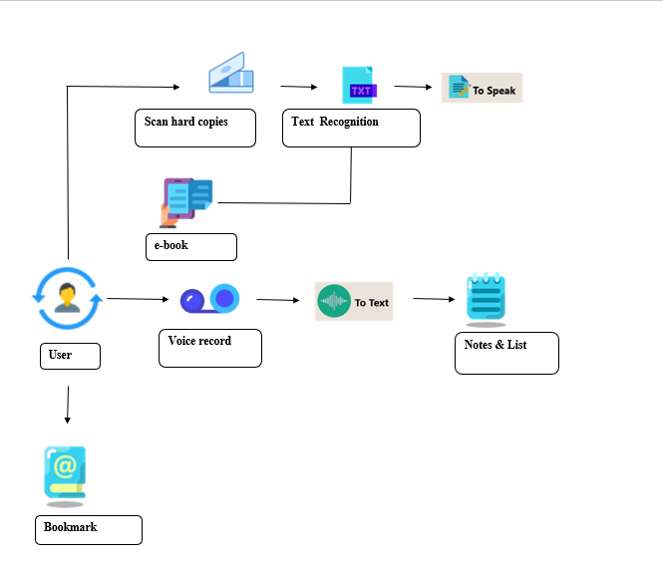
Architecture / Methodology used

Slide 15
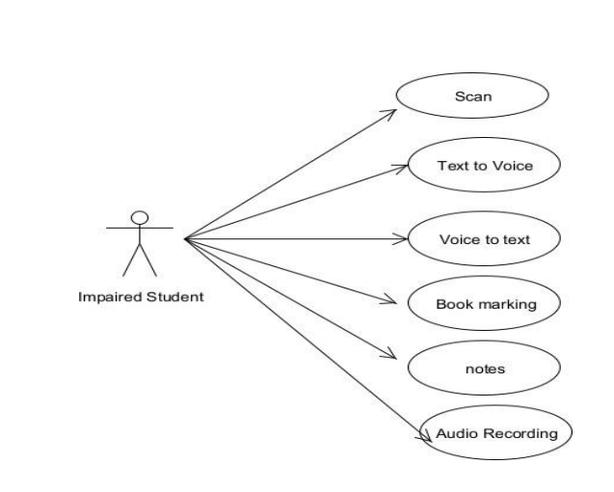
System Design –Use Case diagram

Slide 16
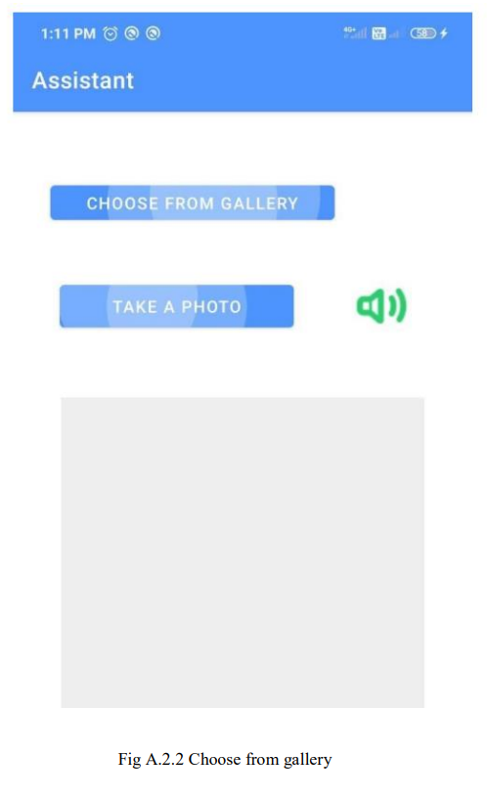
Results

Slide 17
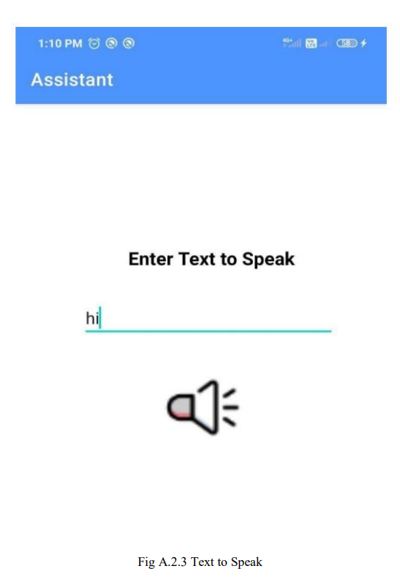
Results

Slide 18
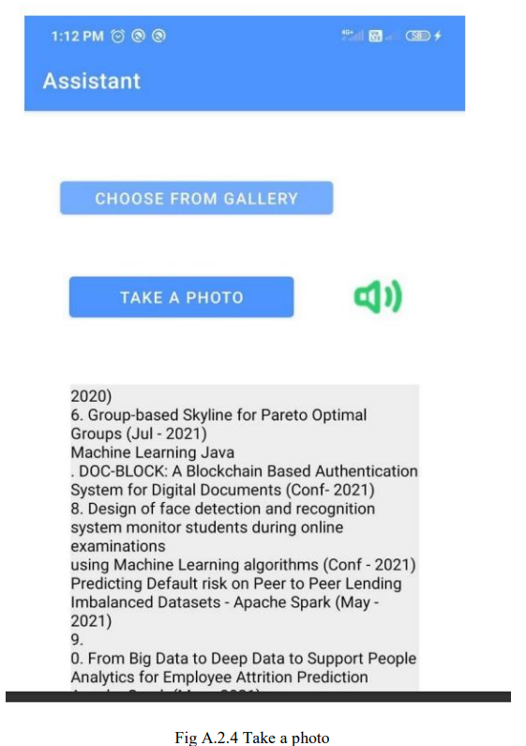
Screen Shots

Slide 19
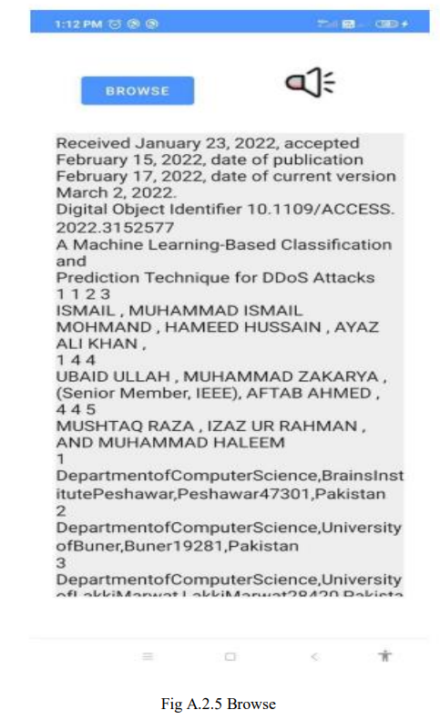
Screen Shots

Slide 20
Feature Enhancement
As for the future we will try to make an application for the iOS platform.
Also at present the application only supports English. We plan to expand and make it available in a wide variety of languages so that it is accessible to people in different parts of the world.
Additionally educational games such as quizzes and word puzzles can be implemented .

Slide 21
Conclusion
The proposed virtual assistant named “Nyx” is an assistive technology which aids the visually impaired. Nyx provides various functionalities such as scanning e-books as well as hard copies, reading texts, keeping notes and adding bookmarks while listening to the audio books. The application mainly focuses on providing easy access to study materials for the blind. Nyx is implemented using various technologies like natural language processing, machine learning, TTS API’s etc.
Our project is highly efficient and user-friendly

Slide 22
Reference Paper/ URL
[1] Prasanna, S., K. Vani, and V. Venkateswari. “Design and Development of a MobileBased Application for Automated SMS System Using Voice Conversion Techfor Visually Impaired People.” In Innovative Data Communication Technologies and Application, pp. 307-317. Springer, Singapore, 2021.
[2] Gayatri.S, Porkodi Venkatesh, Pushpapriya Premkumar, Department of Computer Science and Engineering Jeppiaar SRR Engineering College, Chennai, Tamil Nadu, India, “Voice Assistant for Visually Impaied”, International Journalof Science and Computing March 2019.
[3] “Virtual Assistant for the Visually Impaired”- Proceedings of the Fifth International Conference on Communication and Electronics Systems (ICCES 2020) IEEE Conference Record 48766; IEEE Xplore ISBN 978-1-7281-5371-1
[4] “Voice Assistant for Visually Impaired People”-International Research Journal of Engineering and Technology (IRJET), Nishank M. Tembhurne1, Sumedh V Vaidya, Afrin Shiekh, Prof. Swapnil Dravyakar, Computer Science and Engineering, Priyadarshini Institute of Engineering and Technology, Nagpur.

